Slide 1
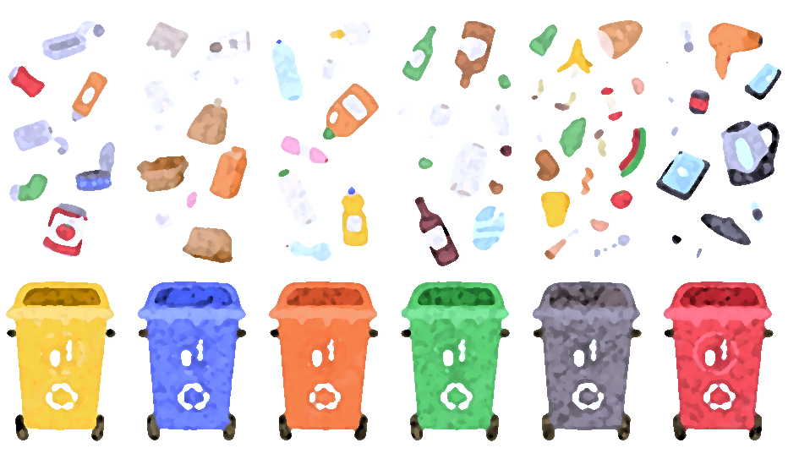
France’s Roadmap to
Innovative Waste Management
JUNE 2024
DSBA | Advanced AI

Slide 2


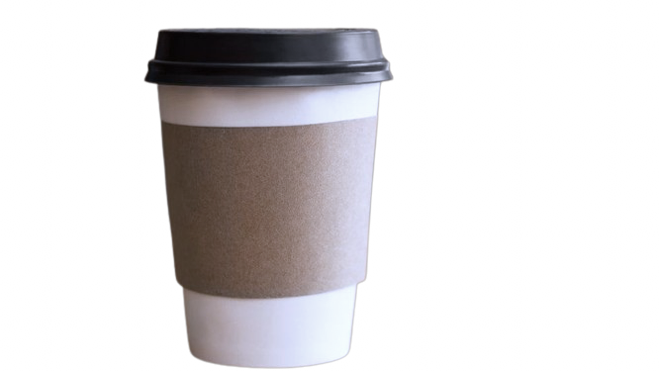
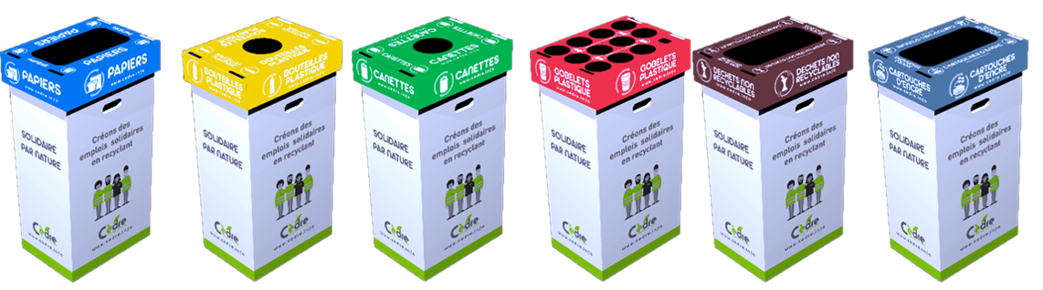
A Quick Sorting Quiz!
used tissue paper
Single-use cup
Plastic packaging

Slide 3

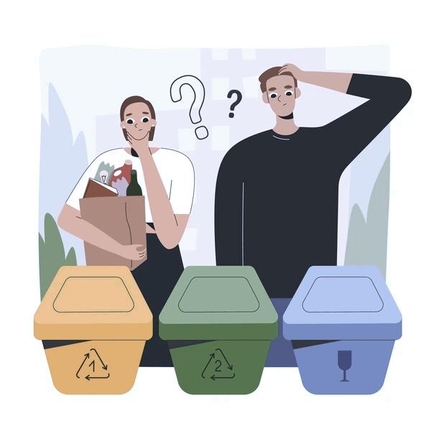

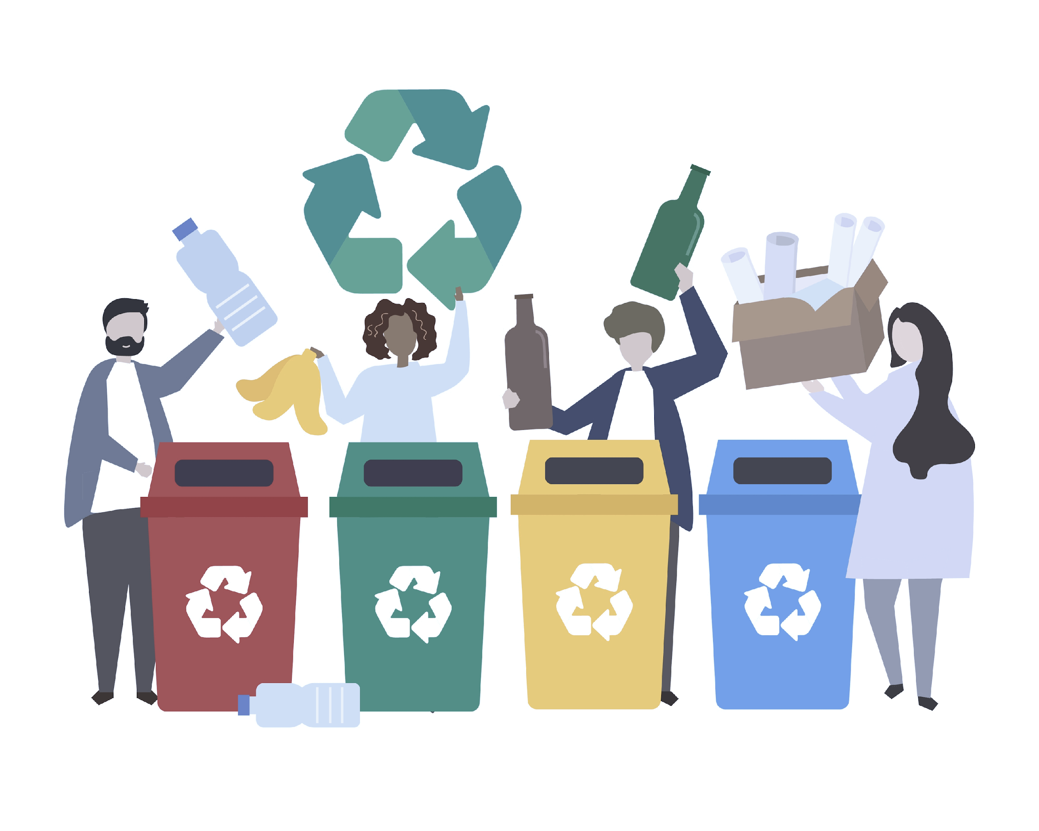
Problem In Hand & its Impact
Inaccurate sorting - Reasons
Inaccurate sorting - Impact
Challenges in recycling mixed waste without advanced technology or extensive human intervention
Contamination rendering entire batches unrecyclable
Countries failing to meet recycling targets
France fails to meet its EU targets:
42% recycling rate (2022), below a 65% pledged 2025 target
Lack of awareness
Confusion
Convenience
Lack of responsibility

Slide 4
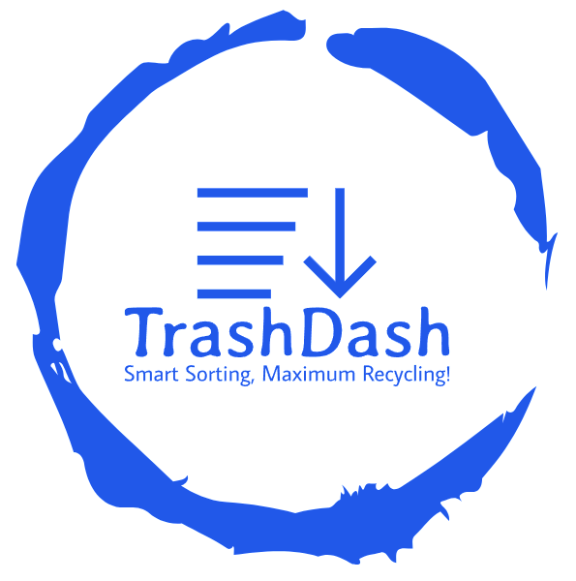
Our solution: TrashDash
01. Automated Trash Sorter
Waste items detection and real-time guidance on disposing waste into color-coded bins
02. Waste Management Tracking
Real-time waste insights via integrated dashboards

Slide 5

TrashDash Demo

Slide 6






Product Technical Flow
Trash Segmentation Displayed
User Interaction
(gamification)
Vision Model (trash detection)
+
GPT4o (trash segmentation)
Real-time monitoring
Analytics data added in database
AI powered Interactive dashboard

Slide 7
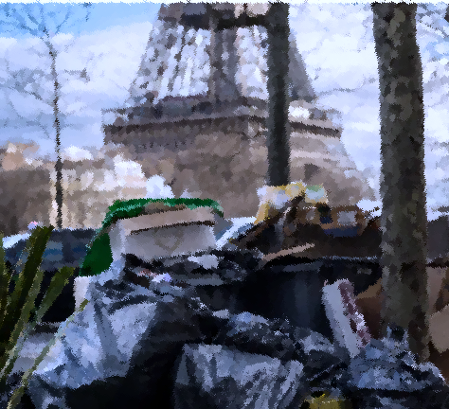

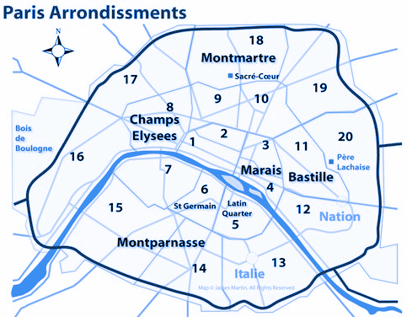

Target Market
In Paris, 3 million tonnes of waste produced annually.
Household waste per capita of 485 kg per year, higher than the national average (2015).
La Défense
Pilot rollout in Year 1 at
Golden Triangle & La Défense
High Business Density
High Impact
Sustainability Driven
Accessibility
g rate for plastic packaging in 2021

Slide 8
Revenue Model
Hardware cost + monthly subscription fee
TrashDash Premium
€40/month
TrashDash Plus
€20/month
AI-powered waste detector*
AI-powered waste detector*
Data Analytics
TrashDash Basic
€10/month
Data Analytics
LLM powered Analytics
(unlimited)
AI-powered waste detector*
LLM powered Analytics
(limited ~ 10 messages/day)
Customizable dashboard
Data Analytics
Customizable dashboard
Full Software customization for gamification
LLM powered Analytics
(limited ~ 4 messages/day)
Limited Software customization for gamification
24/7 support
*at per unit cost

Slide 9
Market Sizing & Revenue Estimation
Hardware Sales
117k companies
(Enterprises, Startups)
€ 3.8mn
#customers * estimated #hardware per customer (7) * Hardware price(€152)
€ 4.32 mn of revenues in the first year
3% estimated adoption rate
3.5k customers
2250 schools
(Public, Private, International)
Monthly subscriptions
€ 525K
#customers * average sale price(€125) *12
Profit Margin
1.3%
Hardware
70%
Subscription

Slide 10





Key Partnership Strategies
Incentivize prices for enterprises through grants
Partner with bin-providers
Implement TrashDash in
public schools
20% of total waste in France is generated by enterprises (off production)
Access to their clients & offer TrashDash as a complementary solution
Large-budget, large-scale client with sustainability objectives
Notes:
ADEME has over 400 million of budget for economie circulaire projects : https://www.ademe.fr/nos-missions/financement/

Slide 11


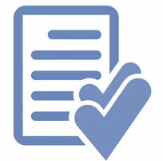
Value Creation
Improved Recyclability Rate
Reduced waste through Analytics
Improved compliance and reporting
We aim to improve recycling rates from 42% to 50% for the first year, optimized resource usage, increased employee engagement
Target main sources of waste & recyclability rates, Track time evolution
Cost reduction : In 2020, enterprises spent €11.3 billion in waste management.
Adherence to Law 5 flux (papers, glass, wood, metal, plastic)
Align with ESG Protocols : Scope 1 & Scope 3
Notes:
https://easyrecyclage.com/les-dechets-de-bureau-en-5-chiffres/#:~:text=En%20France%2C%20un%20employ%C3%A9%20de,ne%20sont%20toujours%20pas%20valoris%C3%A9s.
https://entreprise.mma.fr/connexionpro/dechets-professionnels.html
https://www.statistiques.developpement-durable.gouv.fr/la-depense-de-gestion-des-dechets-en-2019

Slide 12
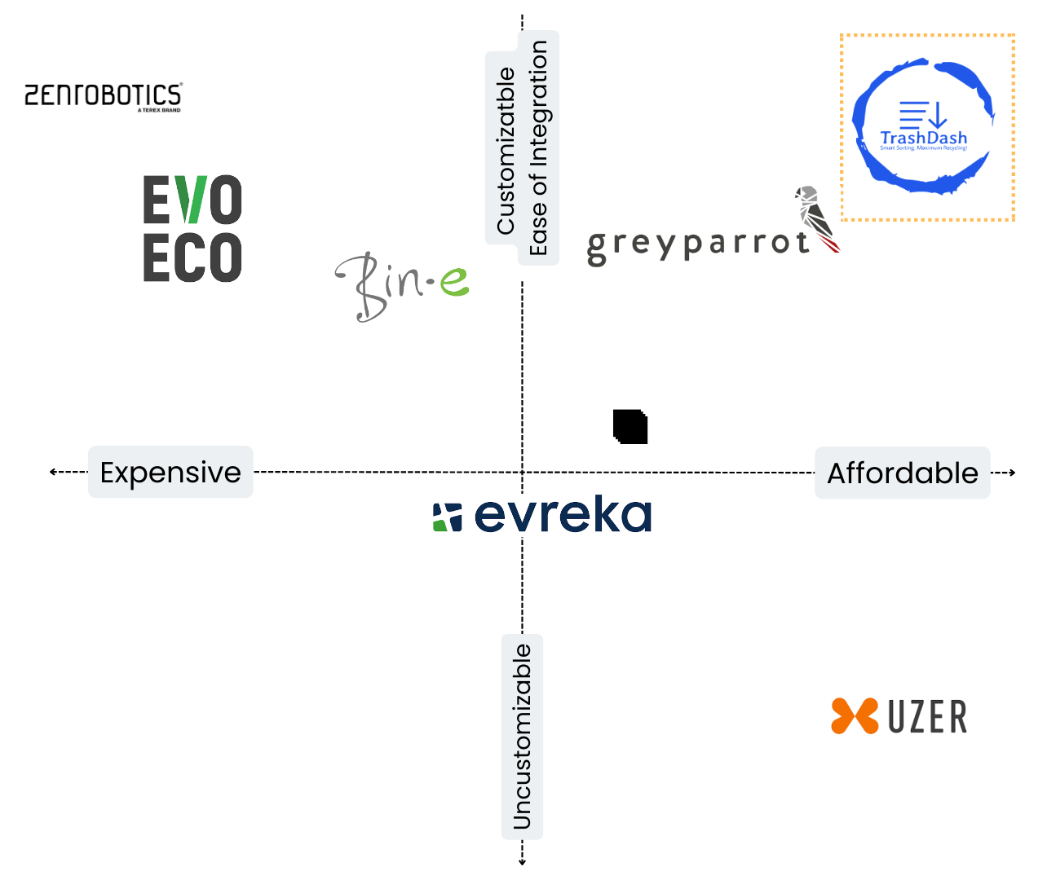





Competitive Advantage
User Engagement Real-time Feedback
LLM powered customizable Dashboard
Fully Customizable Product
Easily Integratable
First market mover in Europe
In-Depth AI Analytics
Sustainability Impact
Notes:
https://easyrecyclage.com/les-dechets-de-bureau-en-5-chiffres/#:~:text=En%20France%2C%20un%20employ%C3%A9%20de,ne%20sont%20toujours%20pas%20valoris%C3%A9s.
https://entreprise.mma.fr/connexionpro/dechets-professionnels.html
https://www.statistiques.developpement-durable.gouv.fr/la-depense-de-gestion-des-dechets-en-2019

Slide 13
Meet the dream team

Slide 14
Thank you!
Questions?
June 2024

Slide 15
Appendix
June 2024

Slide 16
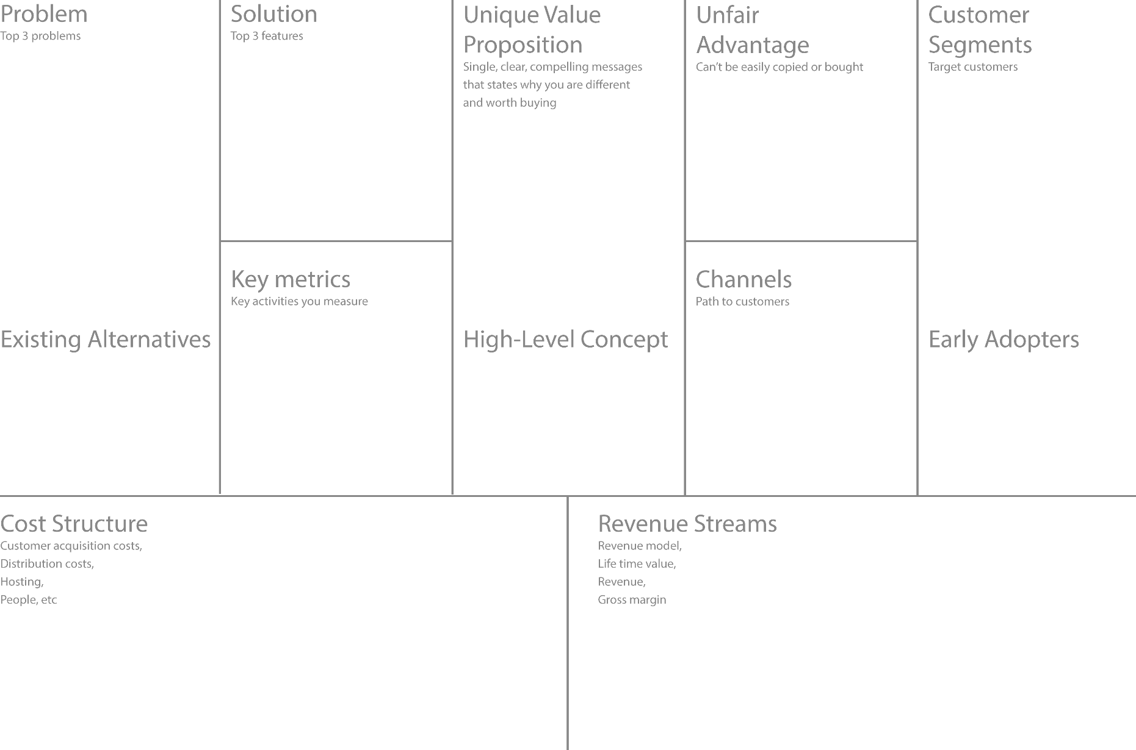
AI-Powered Trash Sorter at source
Monitoring System
Interactive Screens for waste segregation
Real time analytics and insights on waste generated
Inaccurate waste sorting at source
Lack of real time data and insights
Insufficient or ineffective public awareness and engagement
Proprietary Technology
Model enhancement from continuous AI model training
Corporates
Schools
Universities
Commercial Buildings
Advanced AI powered Sorting Technology
Customizable and Scalable Analytics Solution
Dedicated Support and Maintenance
Customer Acquisition Cost
Customer Lifetime Value
Monthly Recurring Revenue
Engagement Metrics
Direct Sales (bin providers)
Partnerships (government, NGOs)
AI-powered sorting tech and real-time data analytics to revolutionize waste management, enhancing recycling rates and sustainability efforts
EvoEco
Greyparrot
ZenRobotics
Corporate Clients with strong sustainable goals
Hardware Cost
Software Development
Sales and Marketing
Operations
Tiered pricing based offering
Annual Subscription model
Advertisement revenue

Slide 17
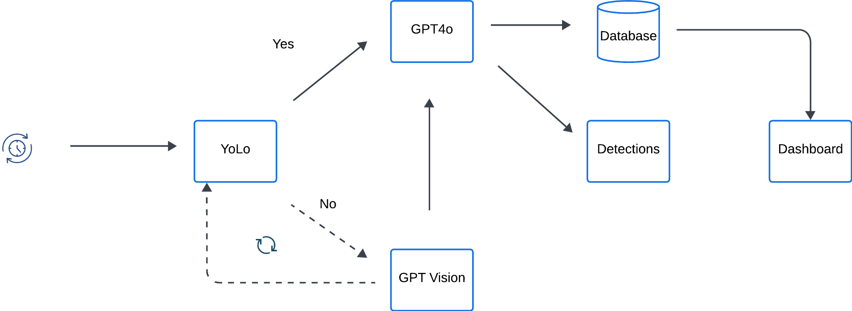
Tech Workflow

Slide 18
Cost Breakdown
To be profitable in the first year, we need 50-60 clients averaging 10 units/client
Costs | Assuming 5000 units (avg 10/client = ~3500 clients) | Our current assumption: 24.5K units (avg 7/client = ~3500 clients)
Hardware & Maintenance Costs | €150 (per unit) = €750,000 for 5000 units | €150 (per unit) = €3.67 M for 24.5K units
Software Costs (model, dashboard, analytics) | €50,000 to €70,000 | €70,000 to €100,000
Cloud Services Costs | €24,000/year | €30,000/year
Total Costs (launching cost) | ~ €840 K | ~ €3.8 M

Slide 19
References
Market Size
https://www.chooseparisregion.org/why-paris-region/the-paris-region-territories/la-d%C3%A9fense
Sorting Guide and System
https://www.connexionfrance.com/practical/change-to-recycling-rules-in-france-and-what-can-go-in-yellow-bins/2301
Competitors
https://www.paris.fr/pages/en-2019-paris-vous-facilite-le-tri-6266
https://www.citeo.com/collecter
Others
https://github.com/insightbuilder/python_de_learners_data/blob/main/code_script_notebooks/projects/LLM_practical_appln/reviewingSummarizers.ipynb
https://github.com/insightbuilder/python_de_learners_data/blob/main/code_script_notebooks/projects/LLM_practical_appln/linking_gmail.ipynb
https://colab.research.google.com/drive/1ieDJ4LoxARrHFqxXWif8Lv8e8aZTgmtH
https://youtu.be/VnksePwe2wo?si=tJdTXTgpG1kDMRBj
https://huggingface.co/DamarJati/GreenLabel-Waste-Types
AUGUST 2032
INFO@COMPANY.COM

